Slide 1
Pancakes
Emma,Elen,Monča,Nela,Eliška,Terka

Slide 2
start
On Tuesday (3thMay) we had Pancake day. The first lesson we learned and the second we went in the kitchen and we started do a pancakes.
We did it two hours.

Slide 3
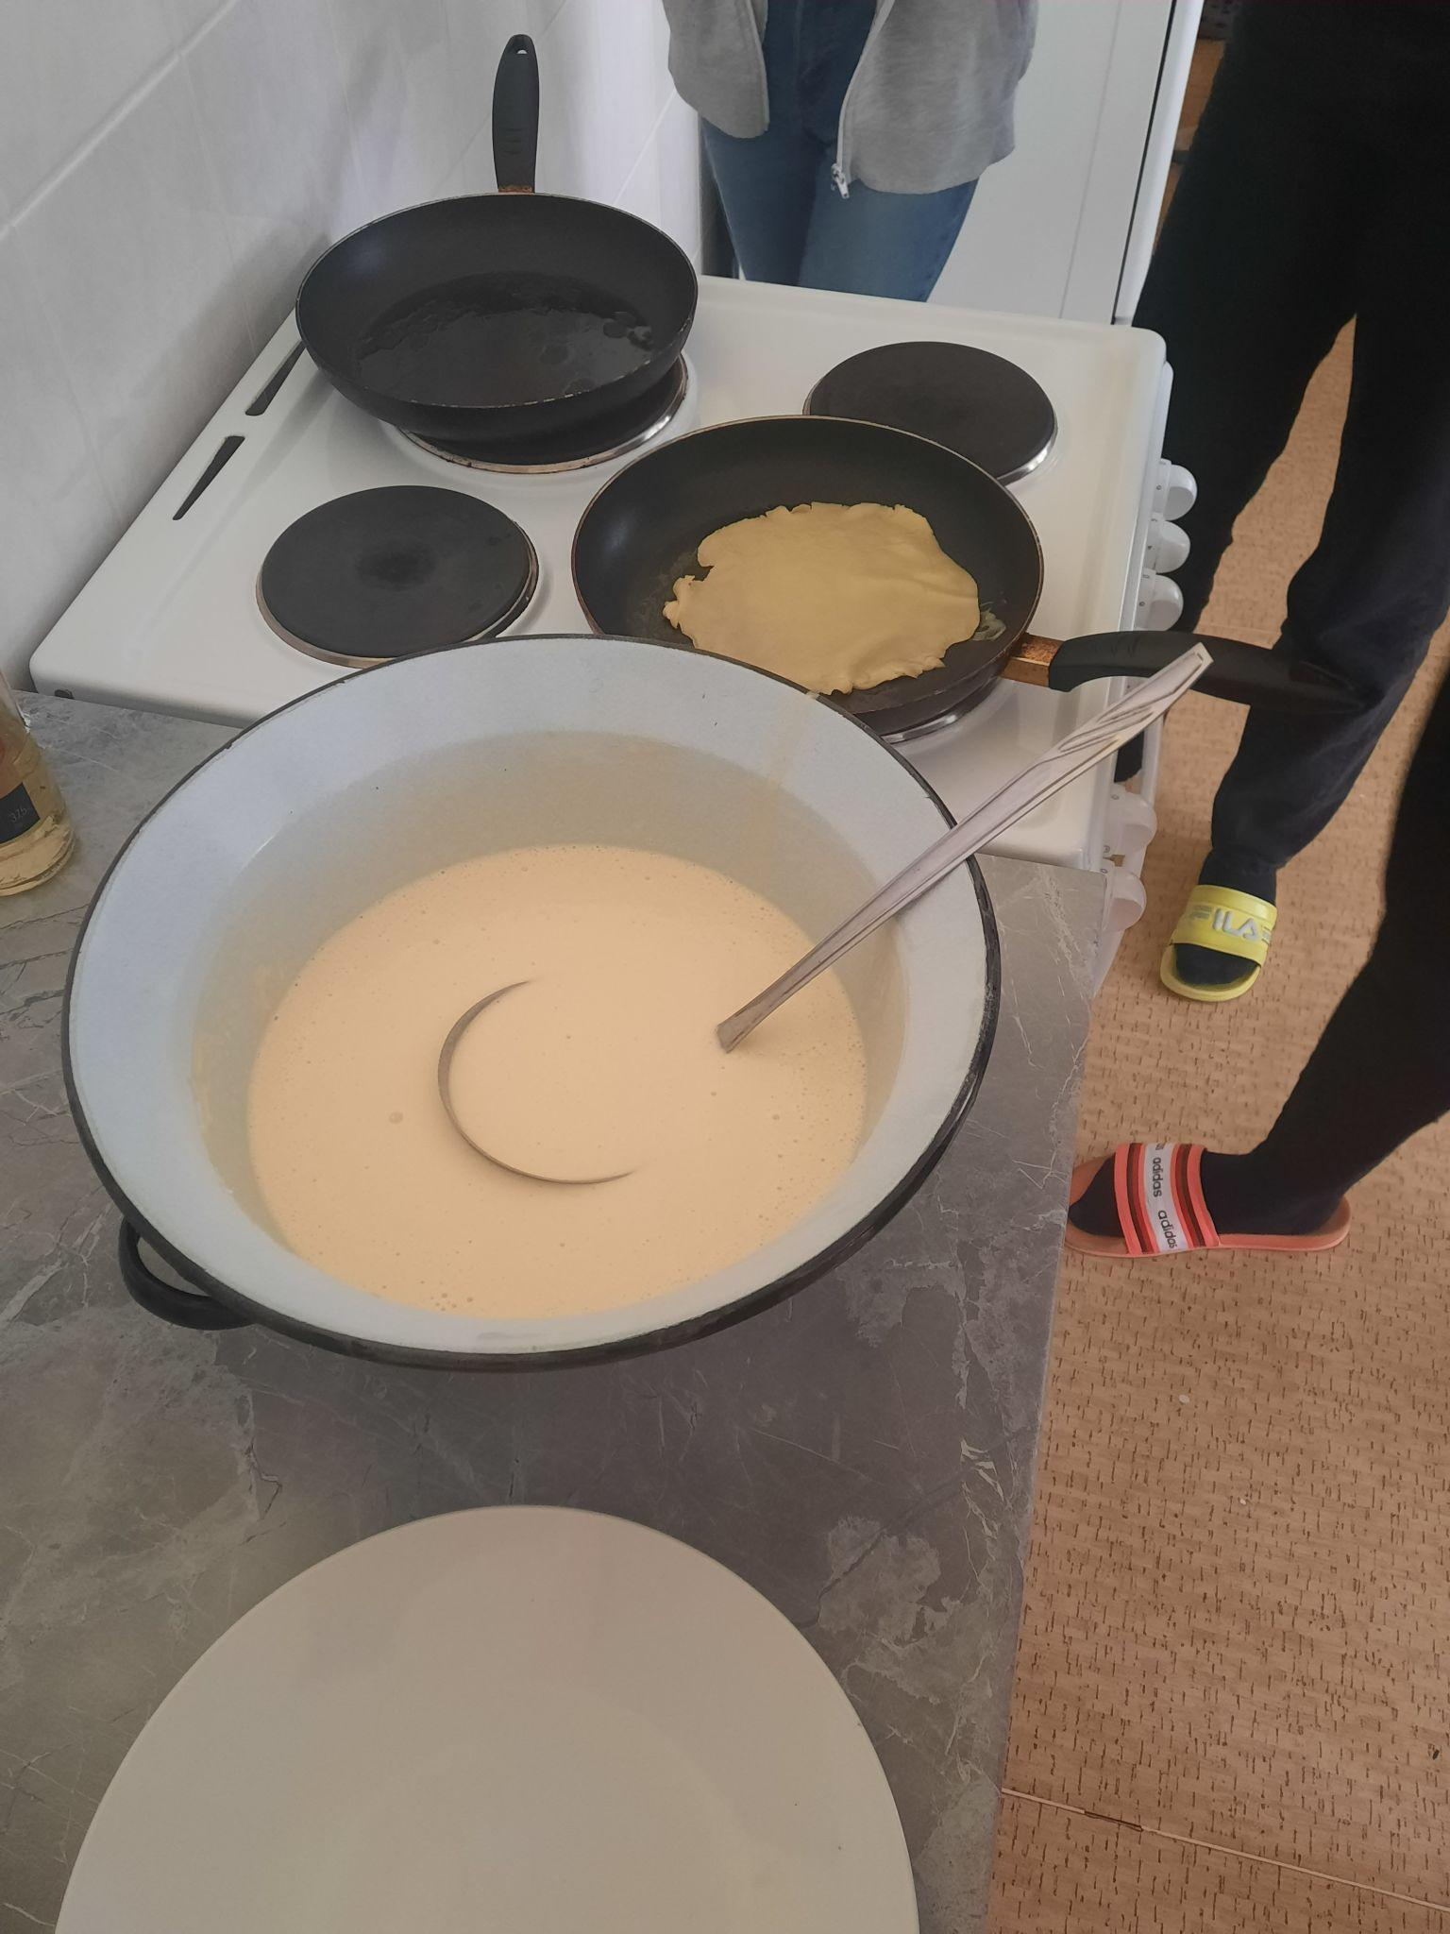
Ingrediens:
eggs, flour, salt, sugar, milk, oil, nutella, jam
the next we used pan, whisk, bowl,....

Slide 4
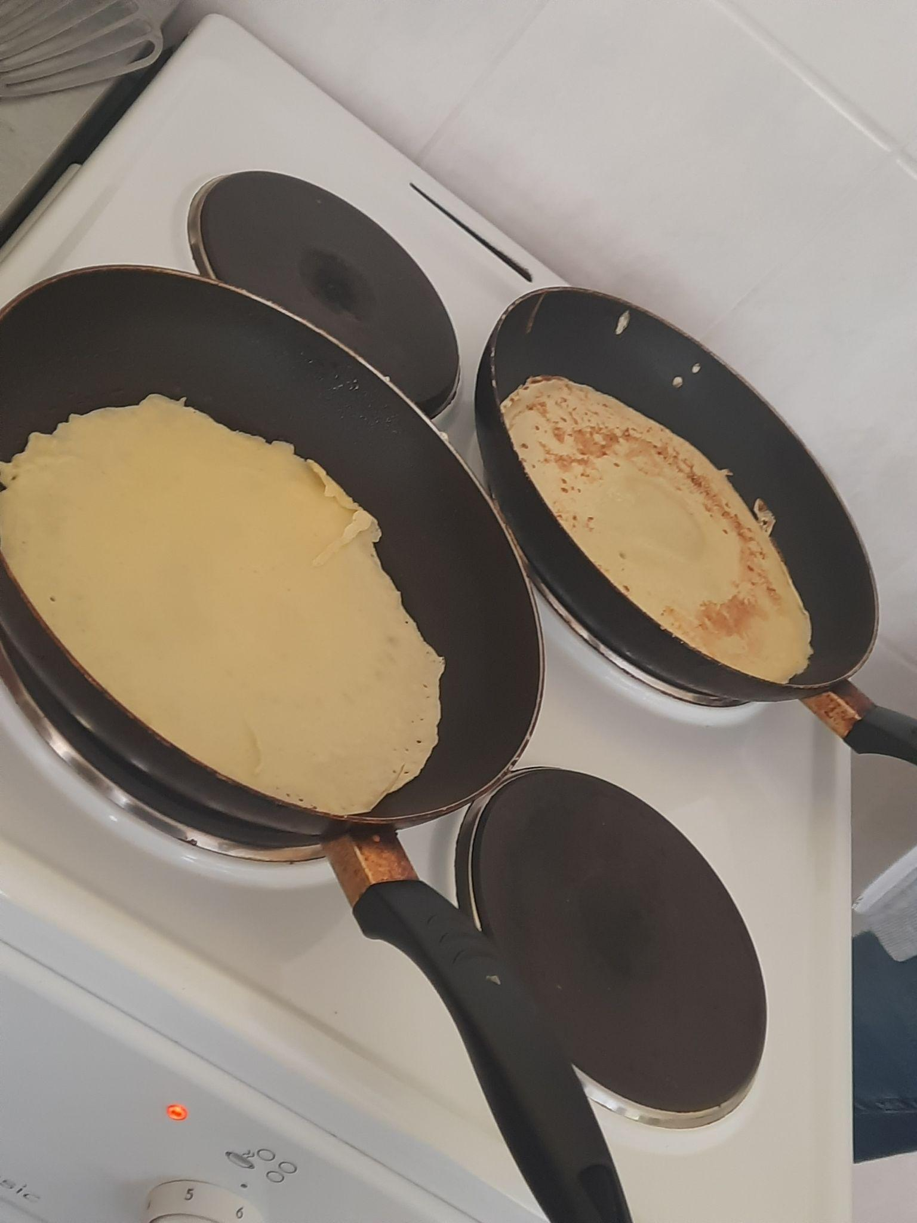
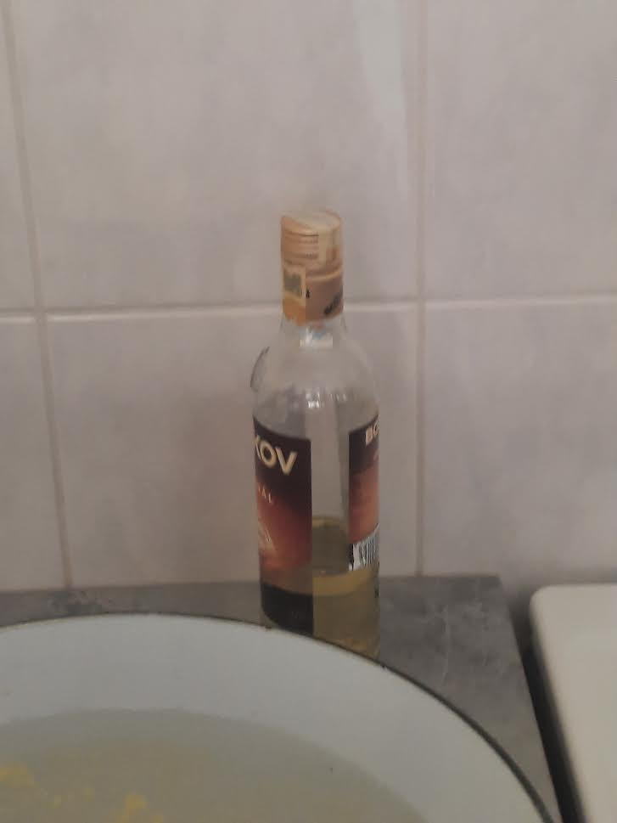

Slide 5
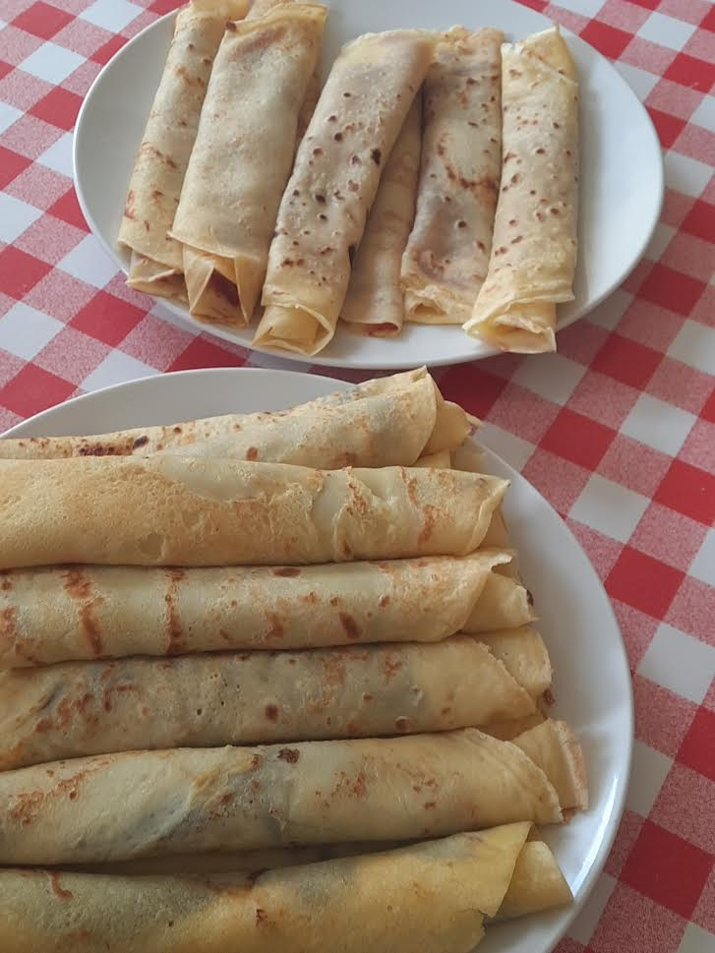
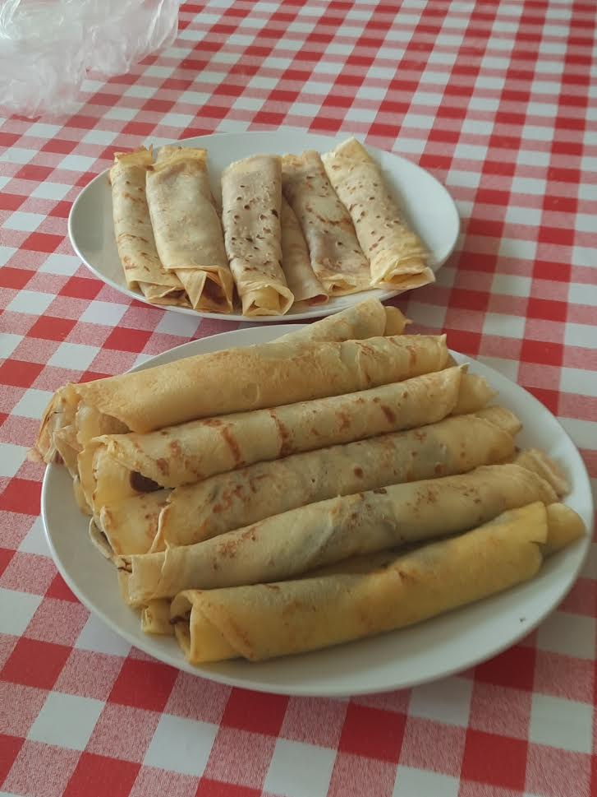

Slide 6
video
Náhled přílohy VID-20220510-WA0000.mp4
VID-20220510-WA0000.mp4
2.5 MB

Slide 7
Thanks for watching

